Slide 1
Midterm Stats
Average: 81.3%
High: 3 students got 100%
Low: 55%

Slide 2
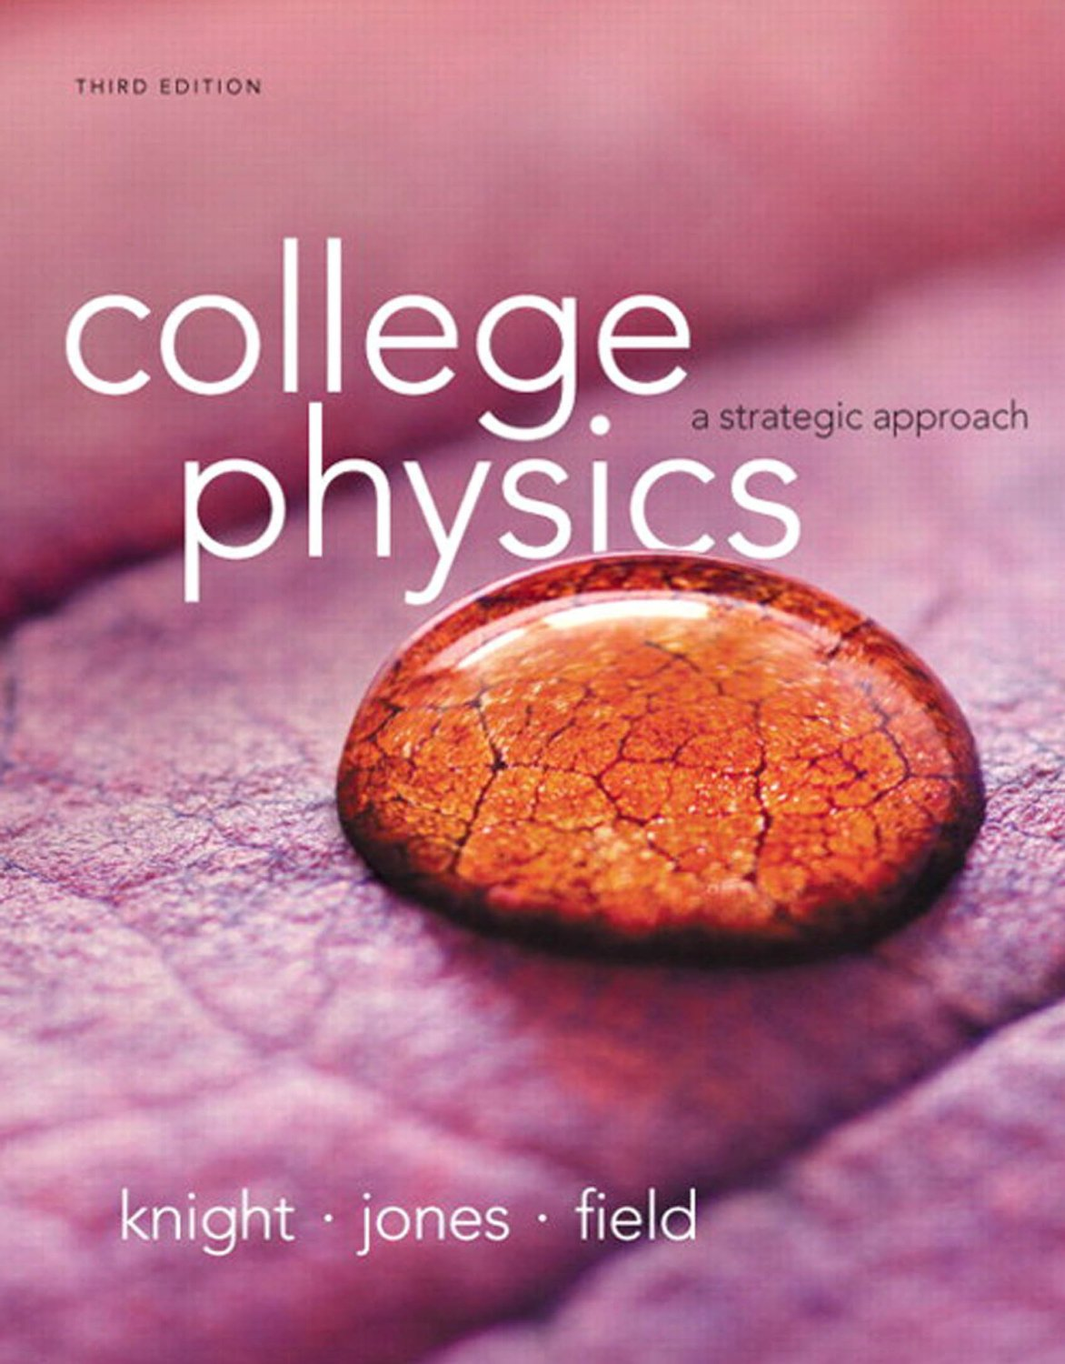
Chapter 9
Momentum

Slide 3


Reading Quiz
The total momentum of a system is conserved
always.
if no external forces act on the system.
if no internal forces act on the system.
never; momentum is only approximately conserved.
Slide 9-7
Notes:
Answer: B

Slide 4
Answer
The total momentum of a system is conserved
always.
if no external forces act on the system.
if no internal forces act on the system.
never; momentum is only approximately conserved.
Slide 9-8
Notes:
Answer: B

Slide 5
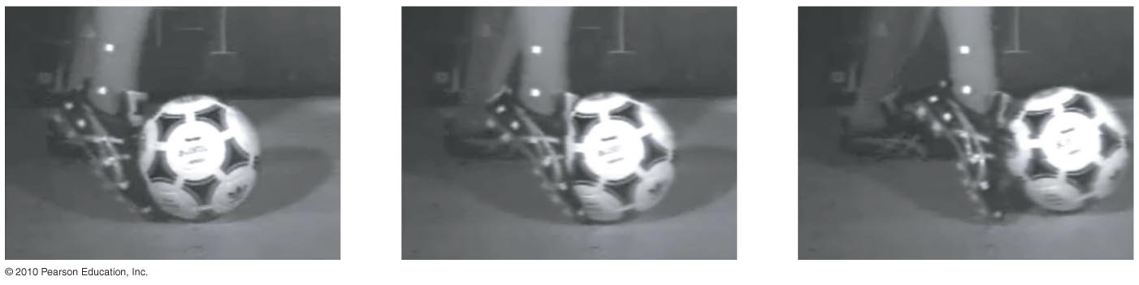
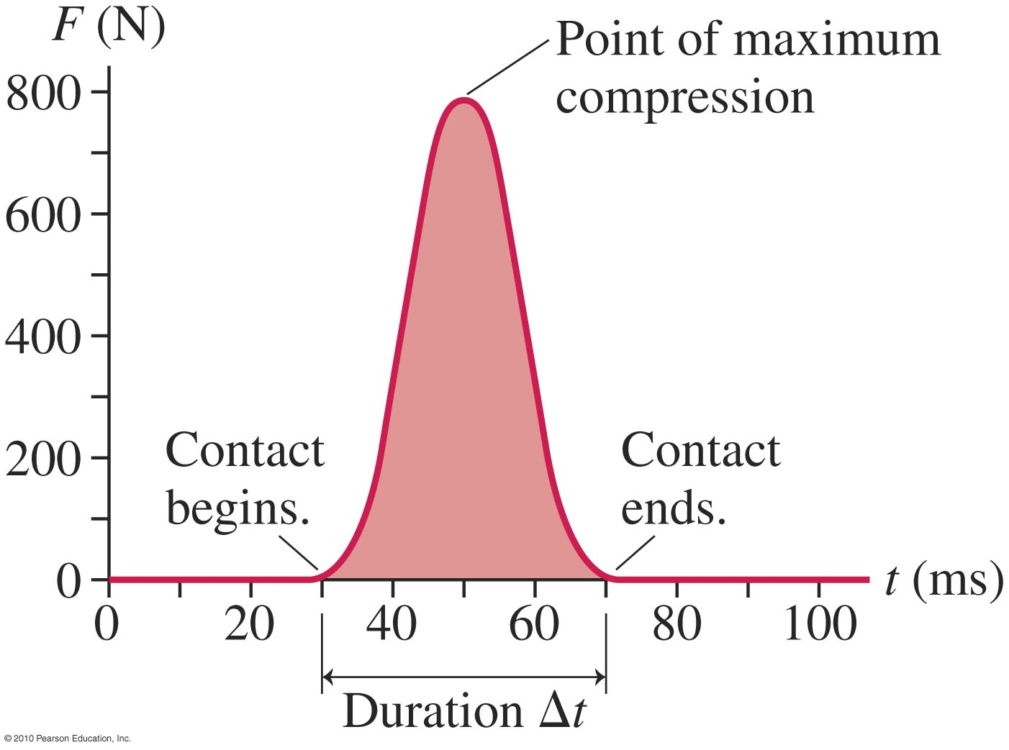
Impulse
The force of the foot on the ball is an impulsive force.
Slide 9-11

Slide 6
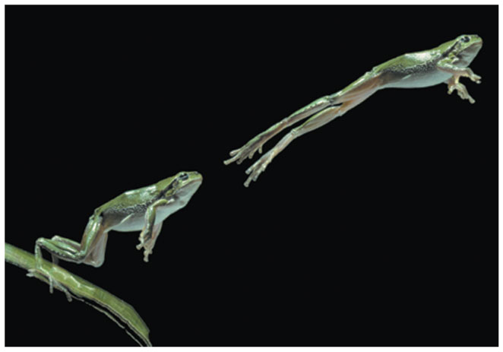
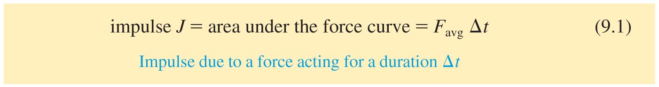
Impulse lifting a frog
How about that?
Notes:
Chapter 9 Unnumbered Figure, Page 257

Slide 7
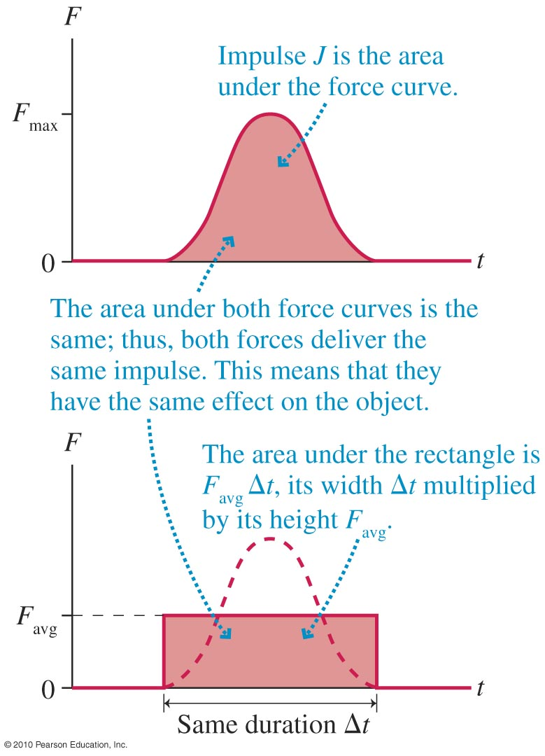
Graphical Interpretation of Impulse
J = Impulse = area under the force curve
Slide 9-12

Slide 8
Reading Quiz
Impulse is
a force that is applied at a random time.
a force that is applied very suddenly.
the area under the force curve in a force-versus-time graph.
the interval of time that a force lasts.
Slide 9-5
Notes:
Answer: C

Slide 9
Answer
Impulse is
a force that is applied at a random time.
a force that is applied very suddenly.
the area under the force curve in a force-versus-time graph.
the interval of time that a force lasts.
Slide 9-6
Notes:
Answer: C

Slide 10
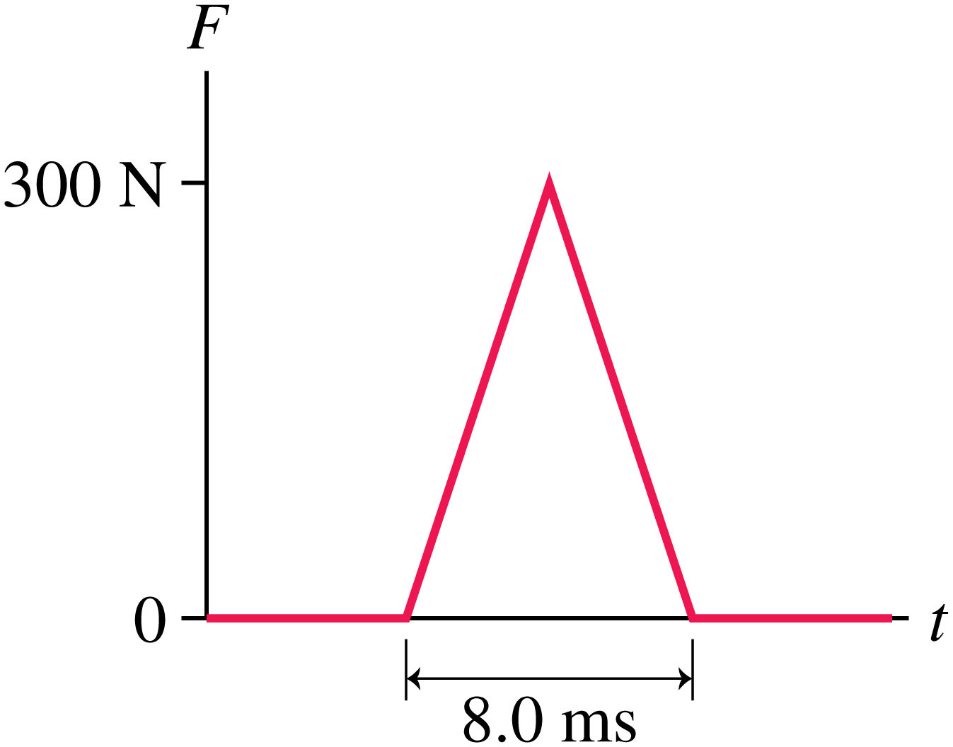
What is the impulse here?
Notes:
FIGURE 9.4

Slide 11
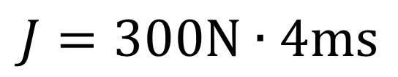
What is the impulse here?
$$J=300\text{N}∙4\text{ms}$$
Notes:
FIGURE 9.4

Slide 12
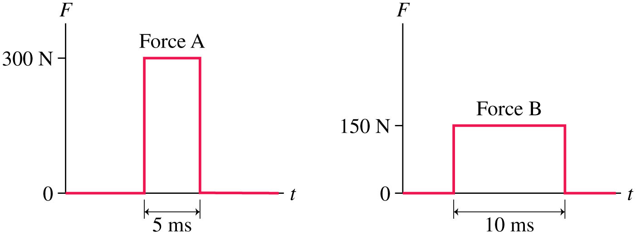
Which one has a greater force? Greater impulse?
Notes:
STOP TO THINK BOX 9.1

Slide 13
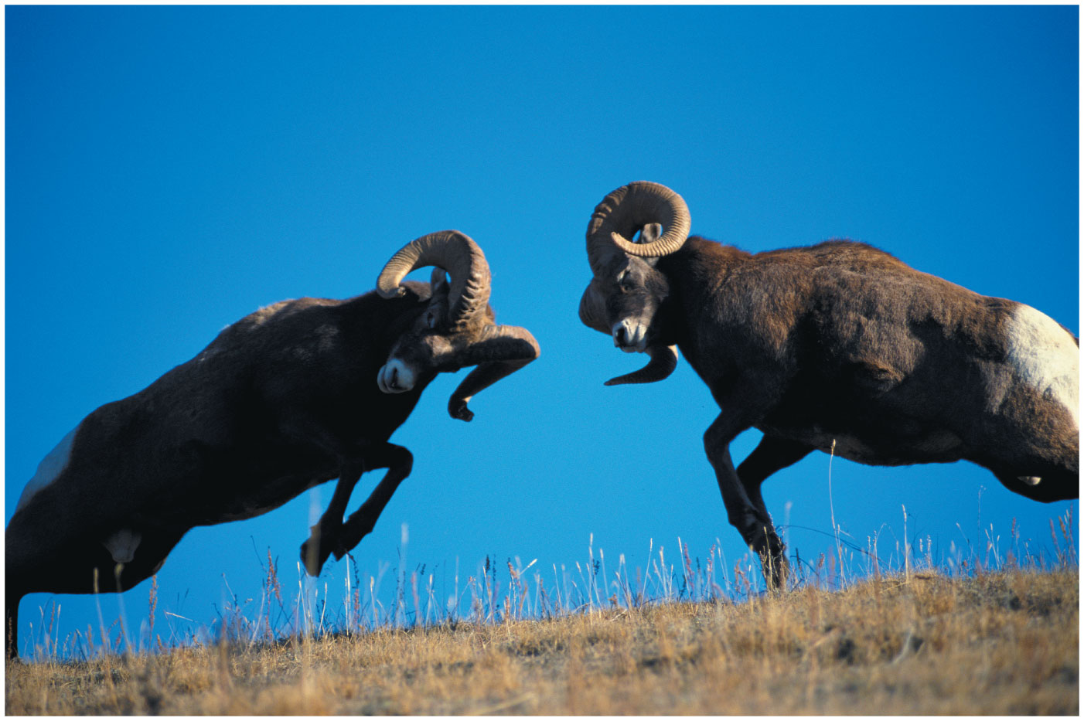
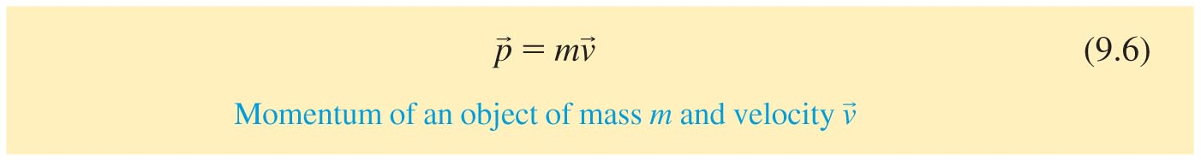
What are the units of impulse?
Notes:
Chapter 9 Opener 1

Slide 14
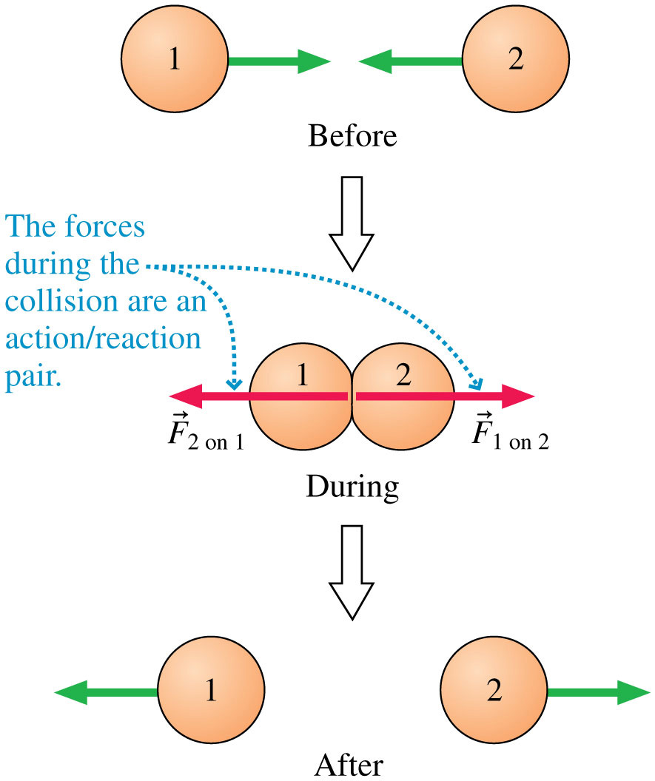
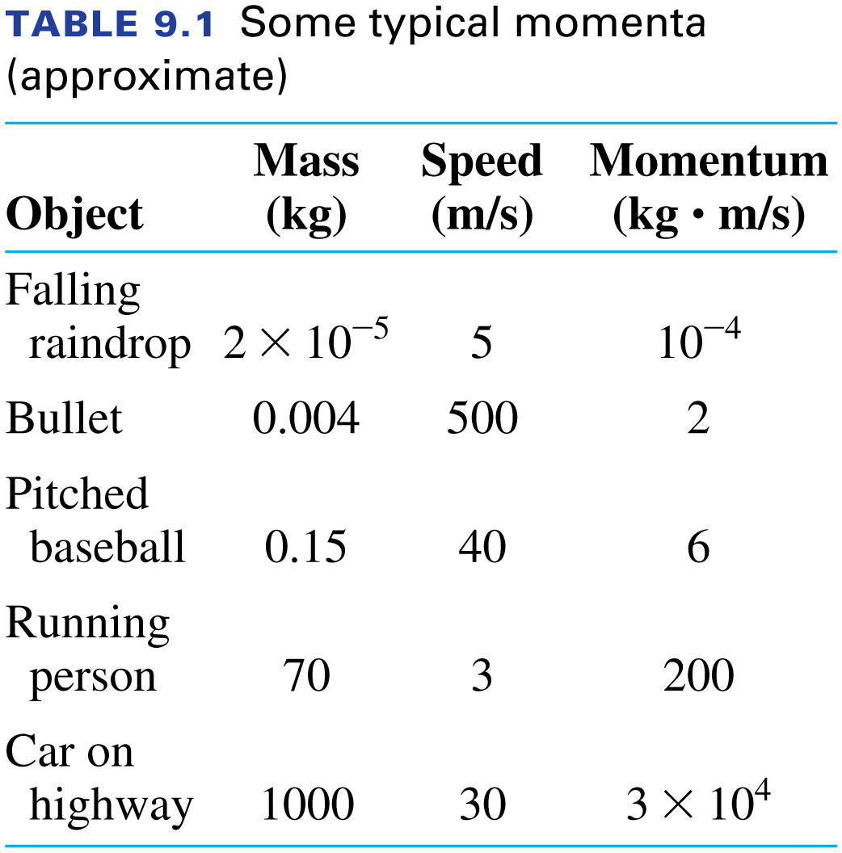
Impulse is a “momentum transfer”
Notes:
FIGURE 9.14

Slide 15
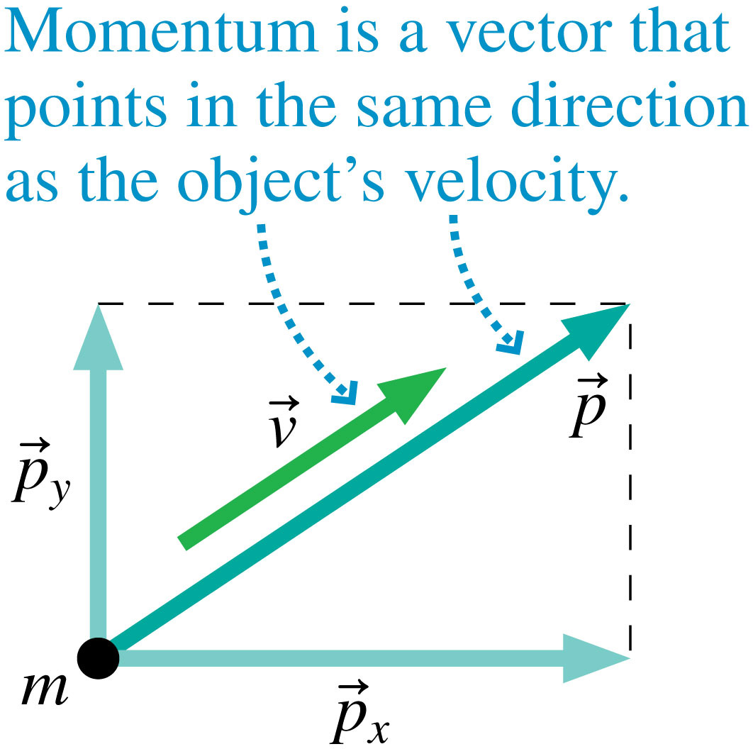
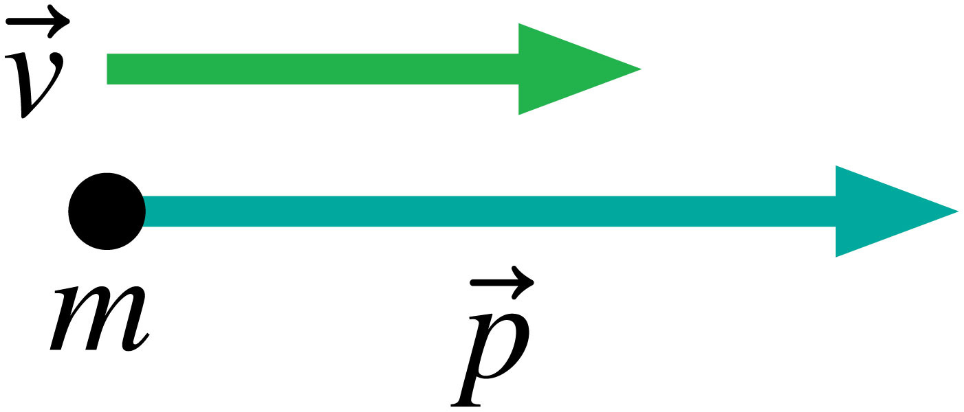
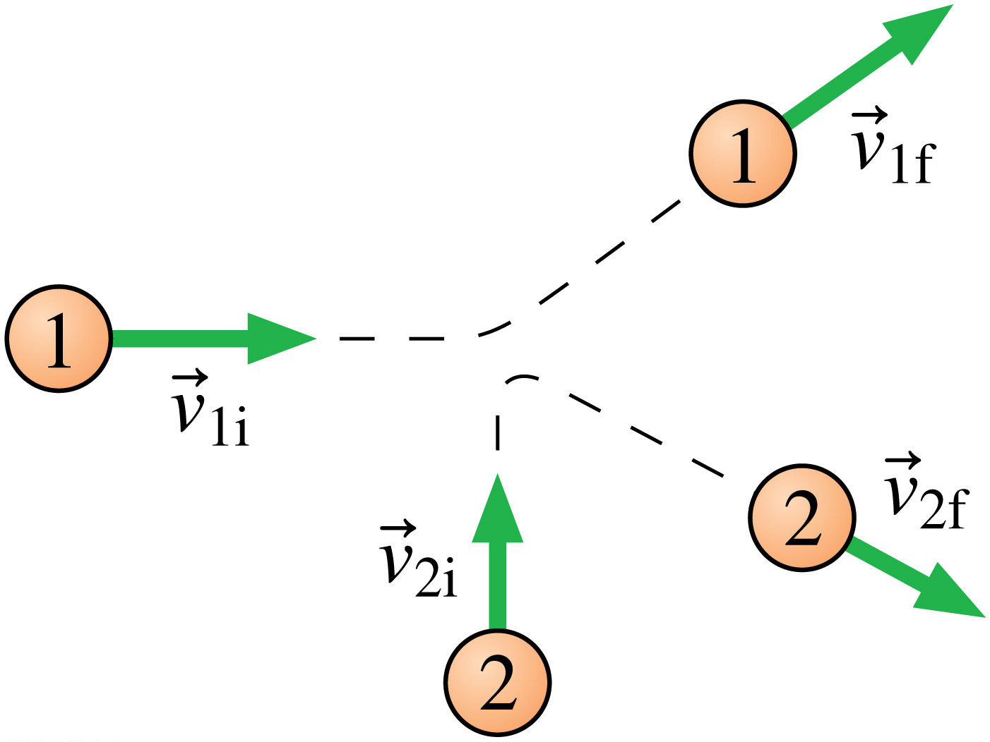
What about momentum transfer in 2 dimensions?
Notes:
FIGURE 9.6

Slide 16
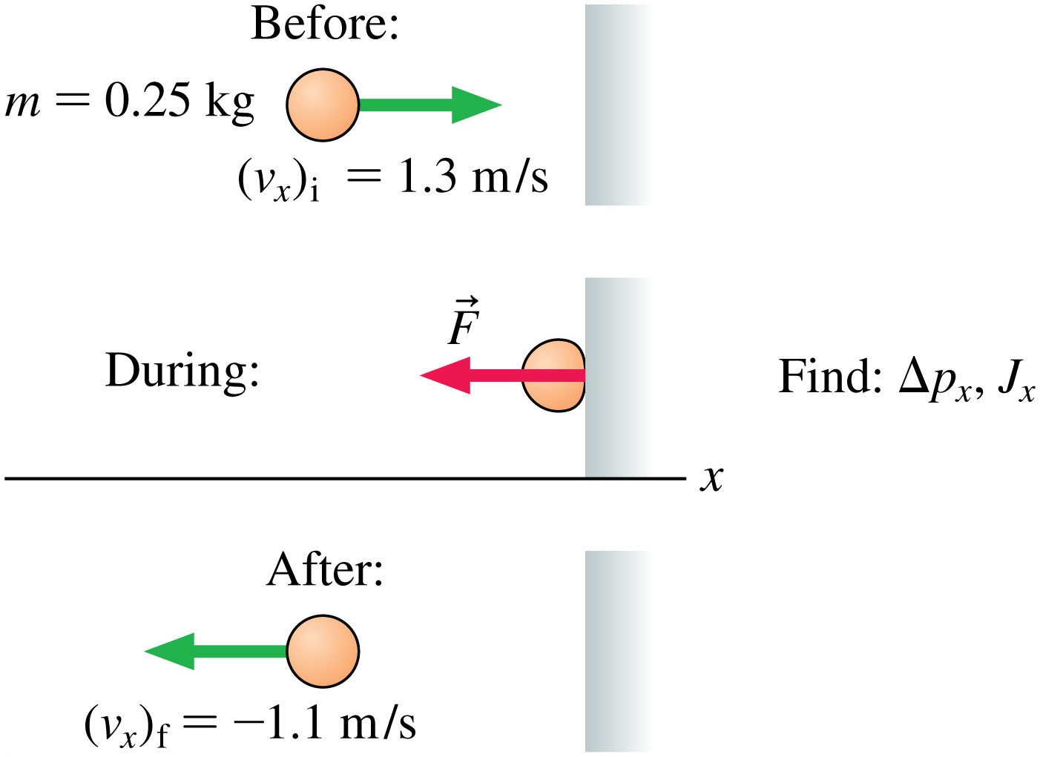

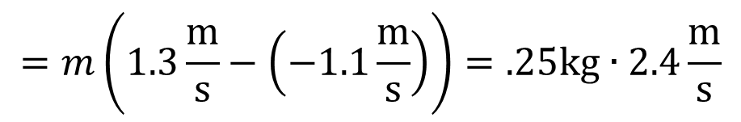


Try this one out
Go head… find those please…
Hey are still reading this?
$$∆p_{x}=p_{f}−p_{i}$$
$$={mv}_{f}−{mv}_{i}$$
$$=m\left(1.3\frac{\text{m}}{\text{s}}−\left(−1.1\frac{\text{m}}{\text{s}}\right)\right)=.25\text{kg}∙2.4\frac{\text{m}}{\text{s}}$$
Notes:
FIGURE 9.8

Slide 17
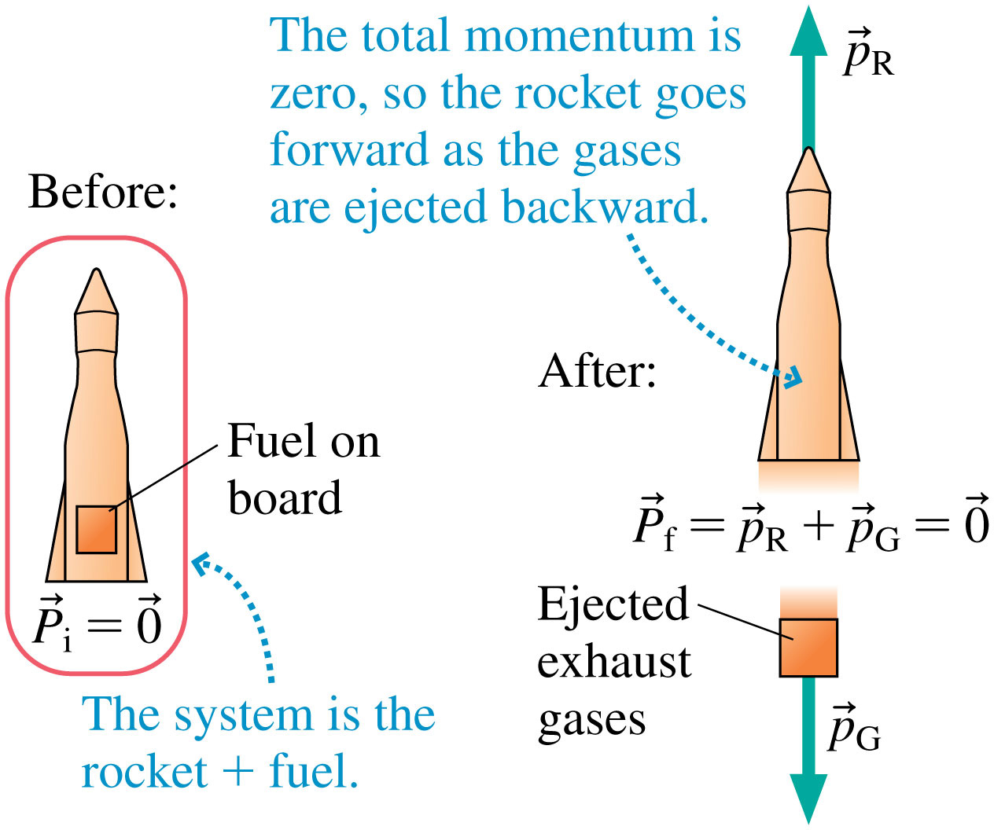
Rocket Science
Notes:
FIGURE 9.21

Slide 18
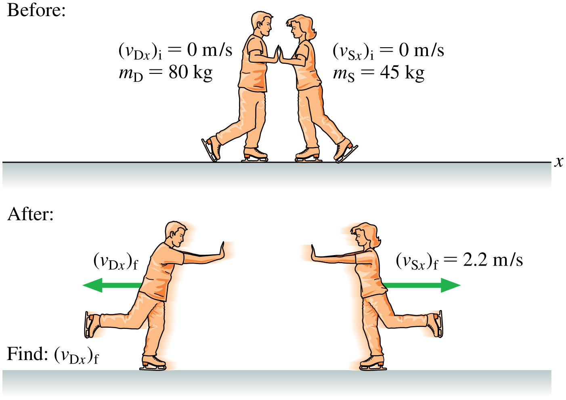
Example Problem
Notes:
FIGURE 9.17

Slide 19
Reading Quiz
In an inelastic collision,
impulse is conserved.
momentum is conserved.
force is conserved.
energy is conserved.
elasticity is conserved.
Slide 9-9
Notes:
Answer: B

Slide 20
Answer
In an inelastic collision,
impulse is conserved.
momentum is conserved.
force is conserved.
energy is conserved.
elasticity is conserved.
Slide 9-10
Notes:
Answer: B

Slide 21
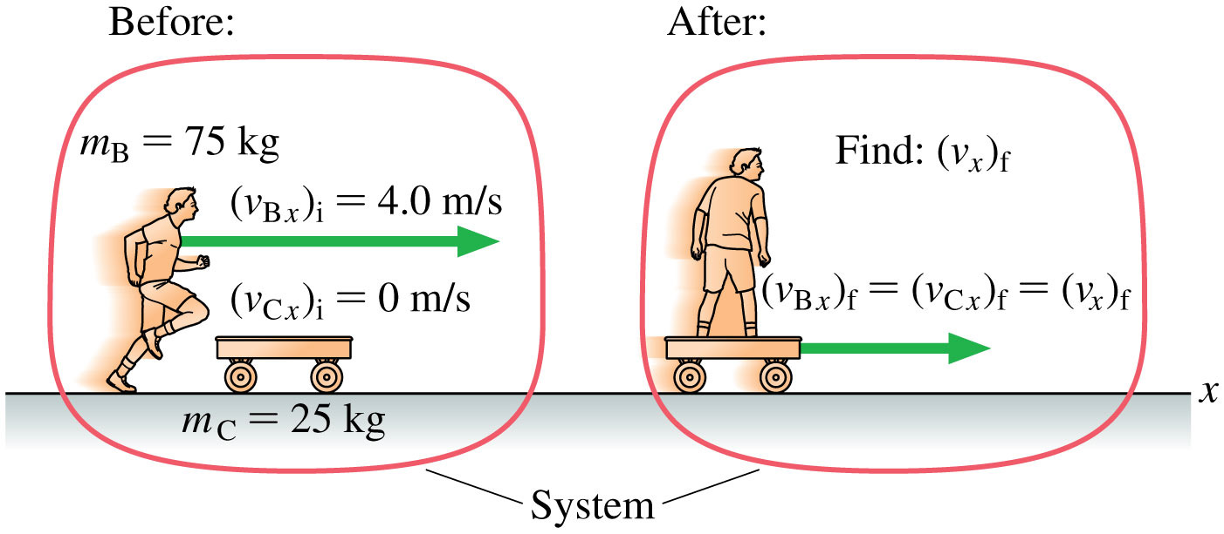
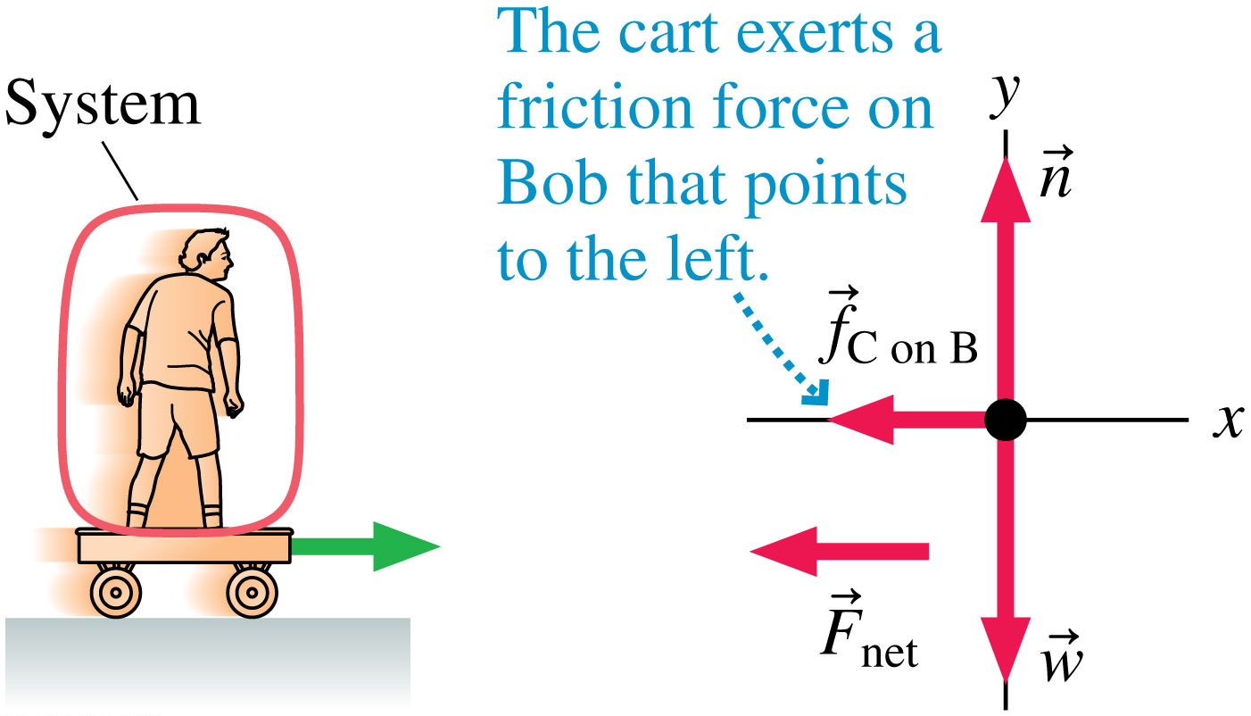
Example Problem
Notes:
FIGURE 9.18

Slide 22
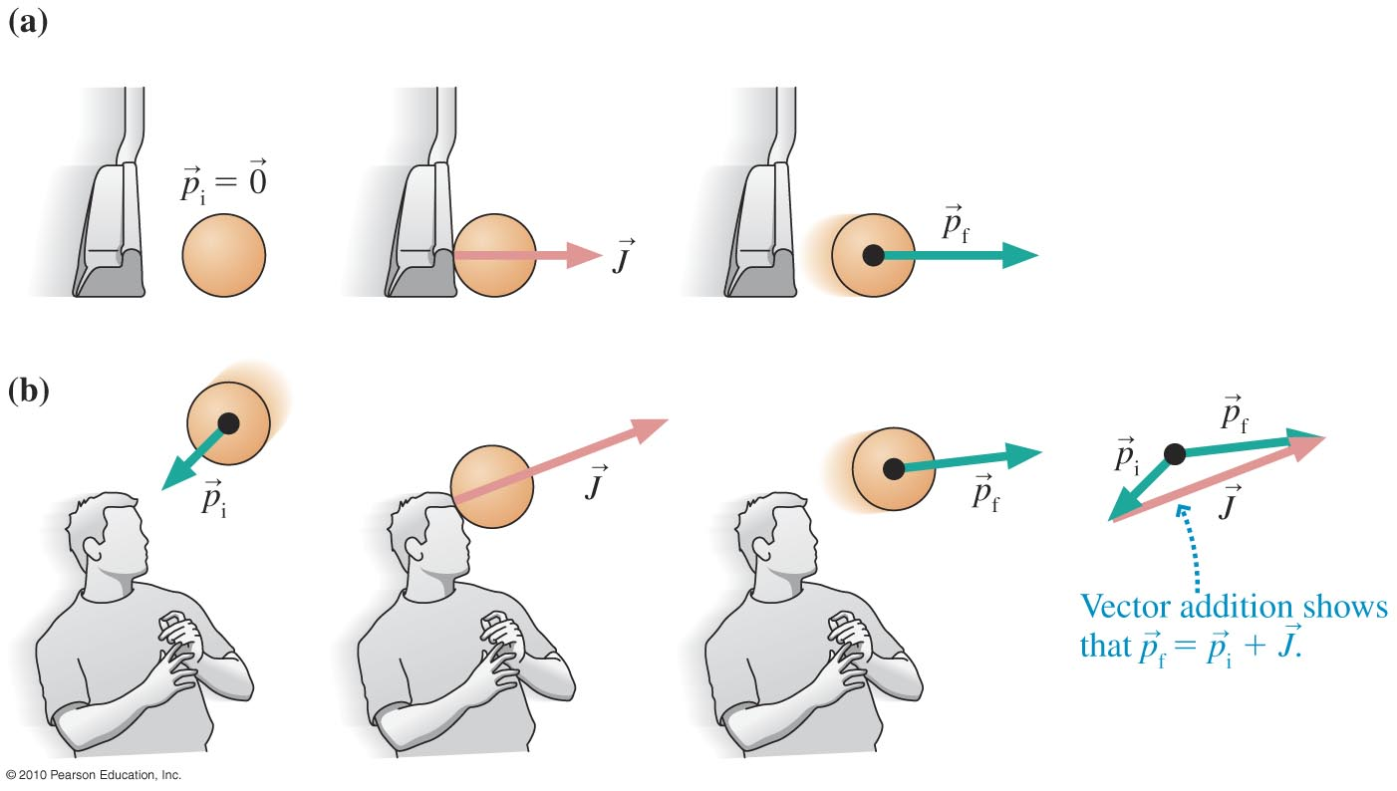
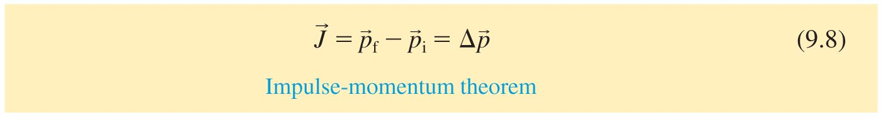
The Impulse-Momentum Theorem
Impulse causes a change in momentum:
Slide 9-15

Slide 23
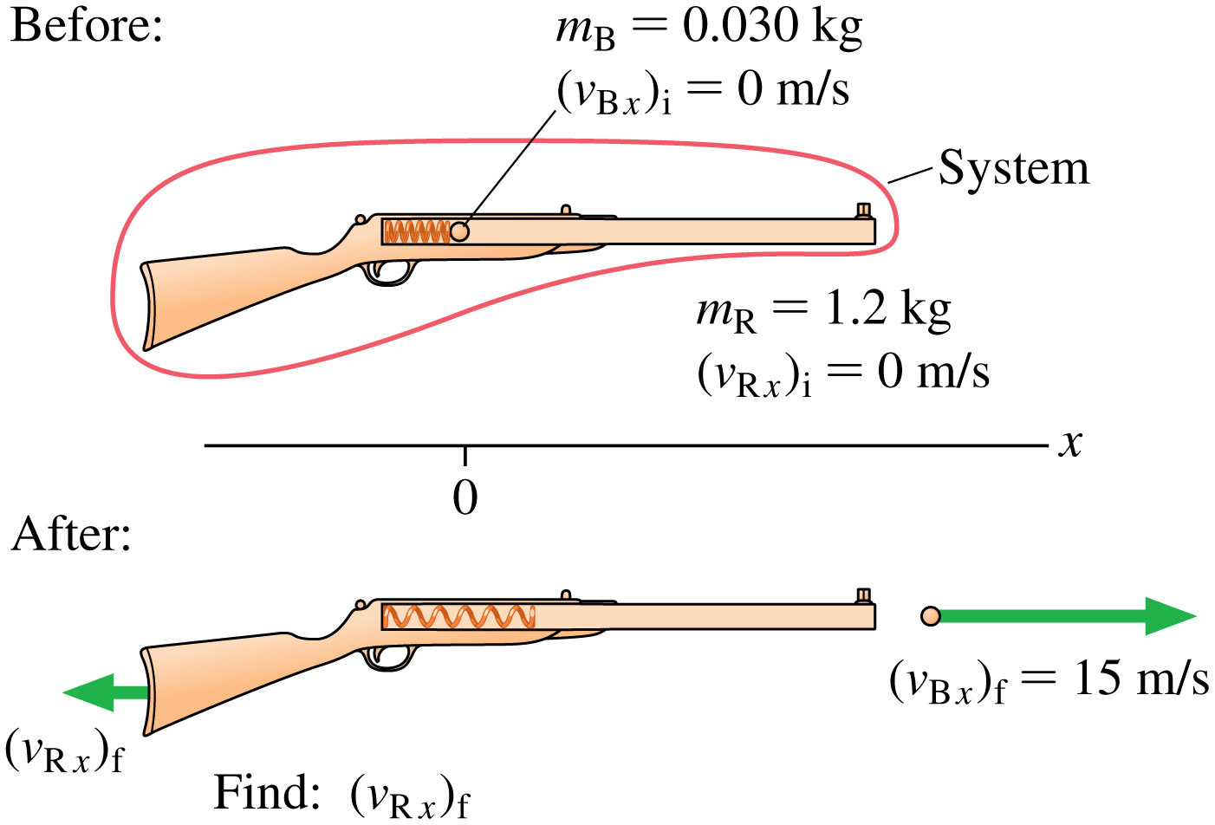
Example Problem
Notes:
FIGURE 9.20

Slide 24
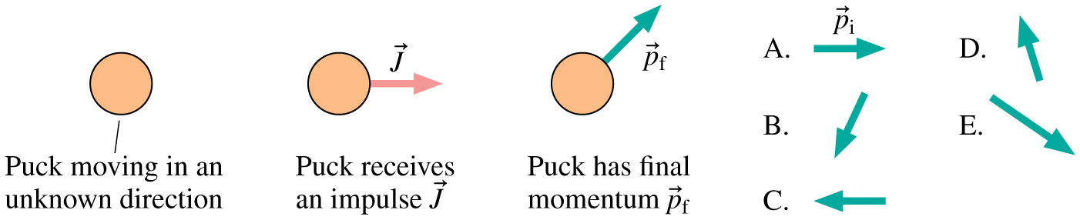
Which final momentum vector is right?
Notes:
STOP TO THINK BOX 9.2

Slide 25
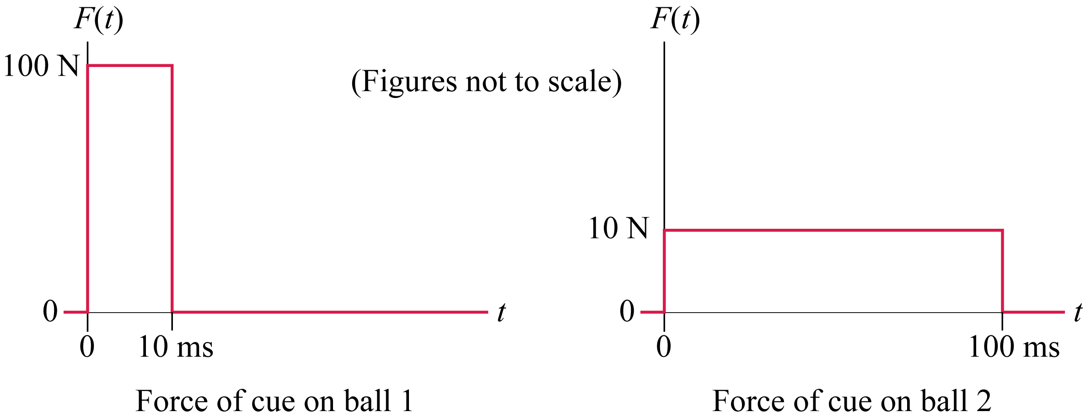
Checking Understanding
Two 1-kg stationary cue balls are struck by cue sticks. The cues exert the forces shown. Which ball has the greater final speed?
Ball 1
Ball 2
Both balls have the same final speed
Slide 9-16
Notes:
Answer: C. Both balls receive the same impulse and have the same mass, so they will have the same final speed.

Slide 26
Answer
Two 1-kg stationary cue balls are struck by cue sticks. The cues exert the forces shown. Which ball has the greater final speed?
Ball 1
Ball 2
Both balls have the same final speed
Slide 9-17
Notes:
Answer: C. Both balls receive the same impulse and have the same mass, so they will have the same final speed.

Slide 27
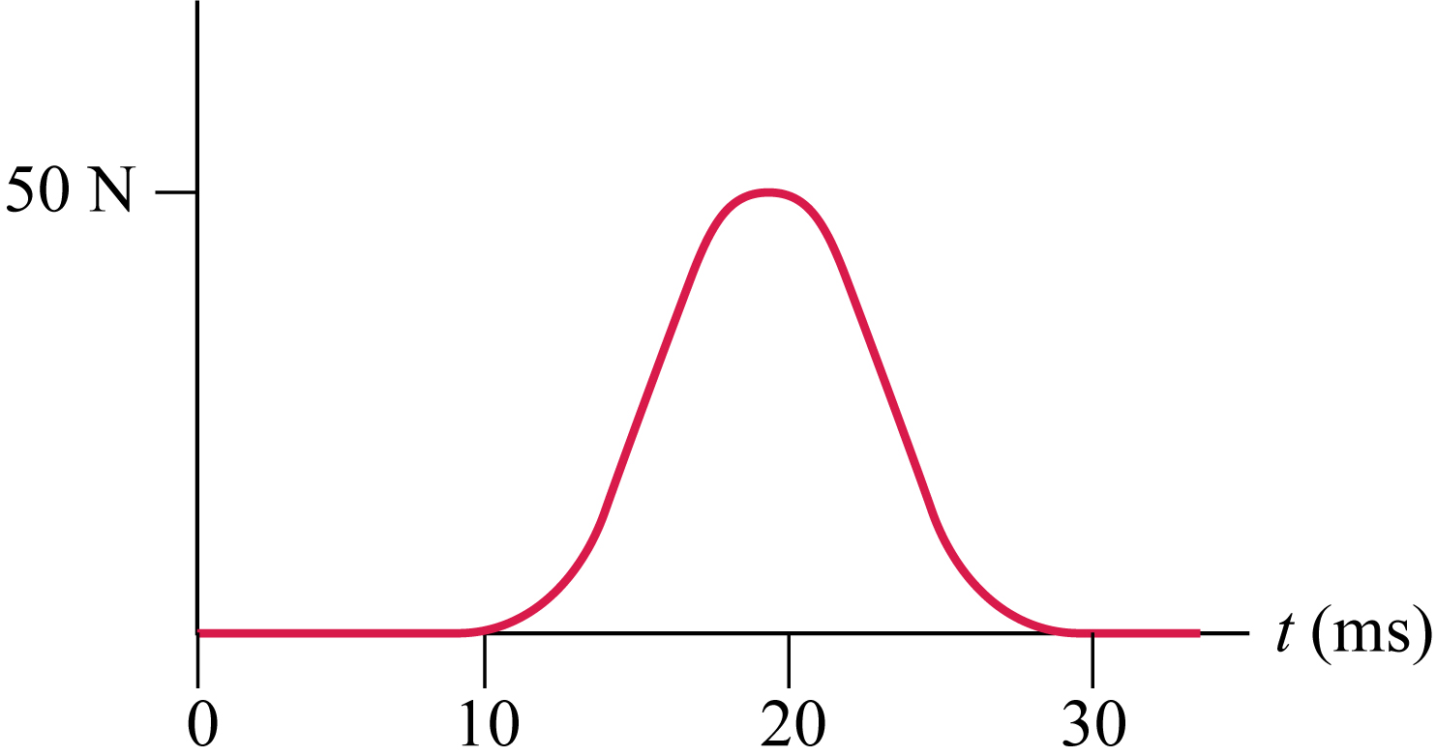
Example Problem
A 0.5 kg hockey puck slides to the right at 10 m/s. It is hit with a hockey stick that exerts the force shown. What is its approximate final speed?
Slide 9-18

Slide 28
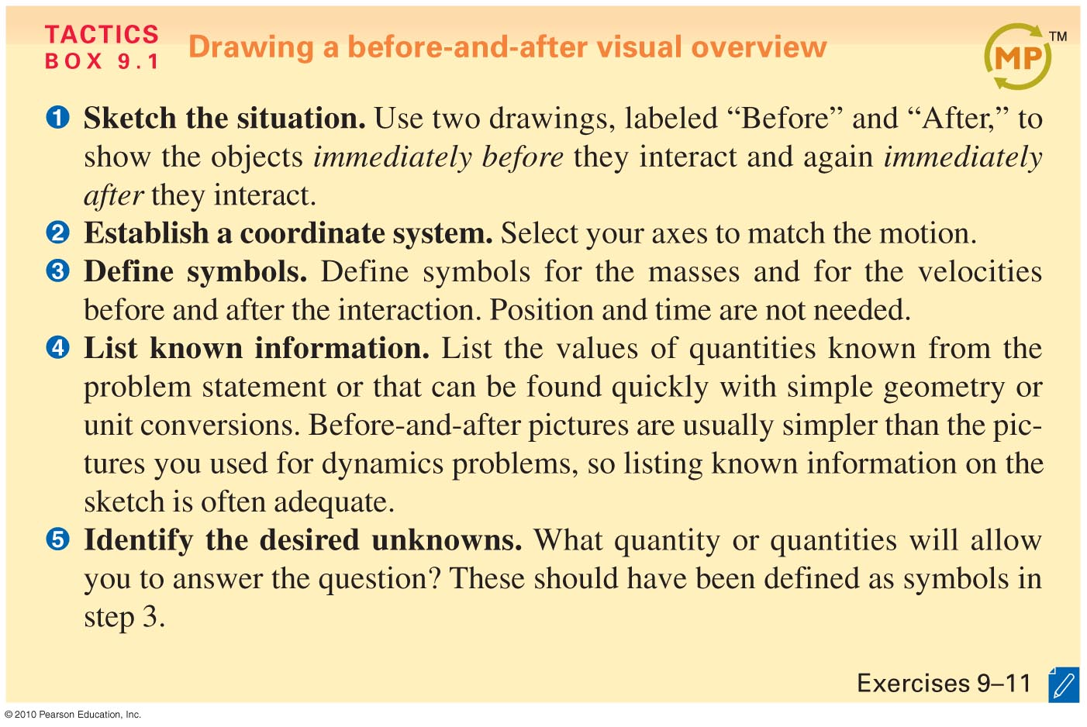
Slide 9-19

Slide 29
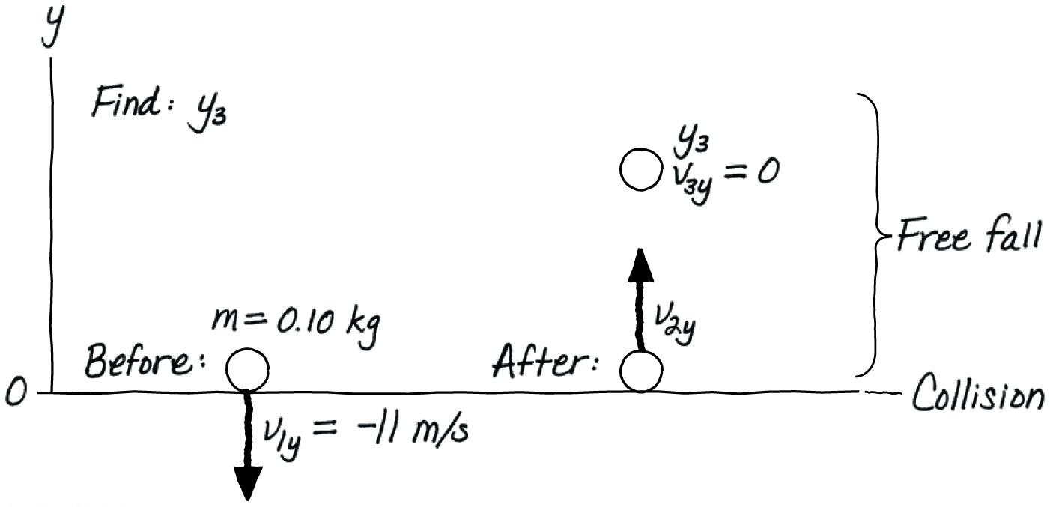
What about…
Notes:
FIGURE 9.13

Slide 30
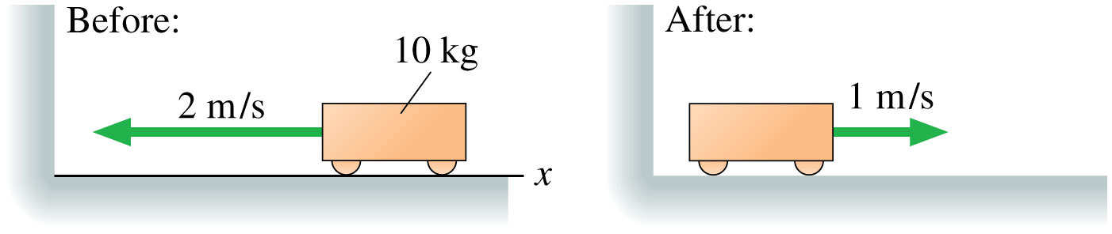
What happened here?
Some momentum was lost to accoustic/thermal effects
NOT A “PERFECT” COLLISION
Notes:
STOP TO THINK BOX 9.3

Slide 31
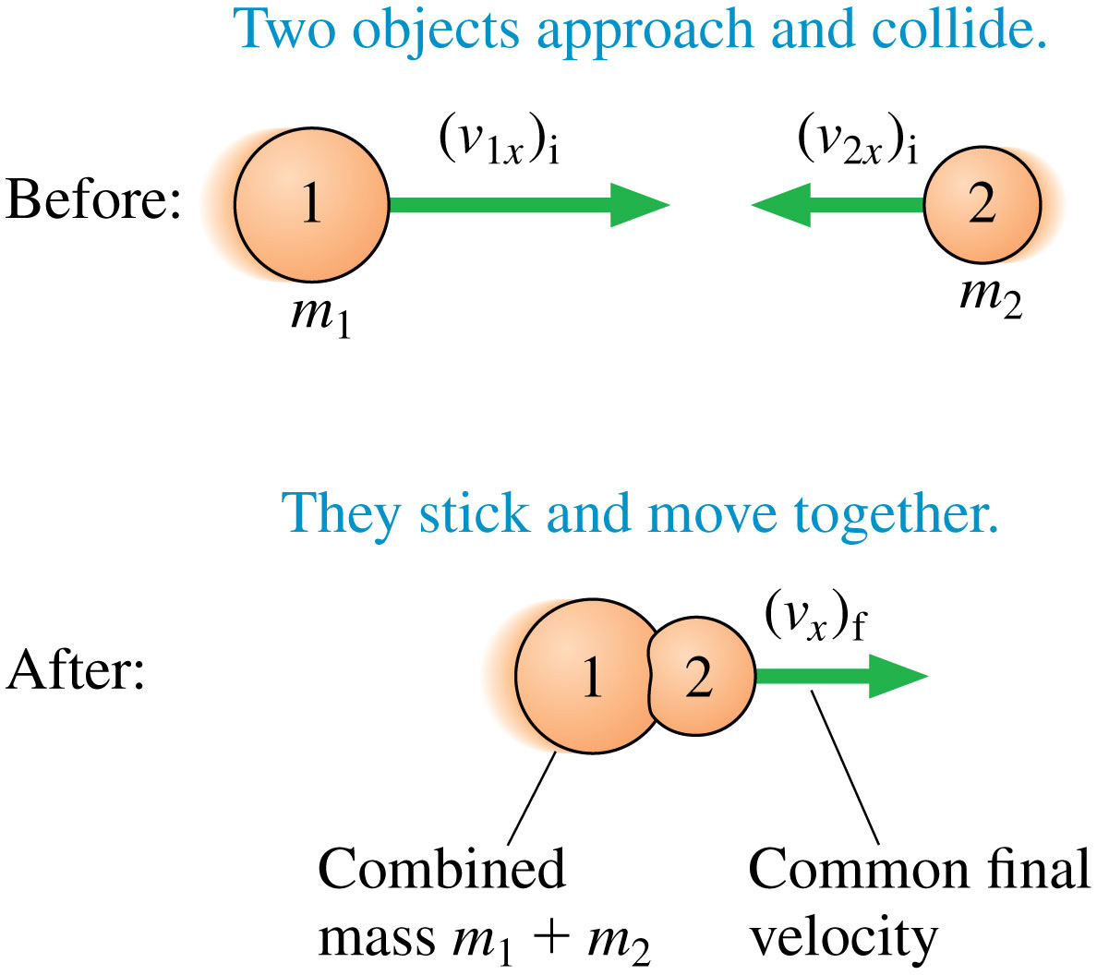
The inelastic collision
Notes:
FIGURE 9.22

Slide 32
You may begin

Slide 33
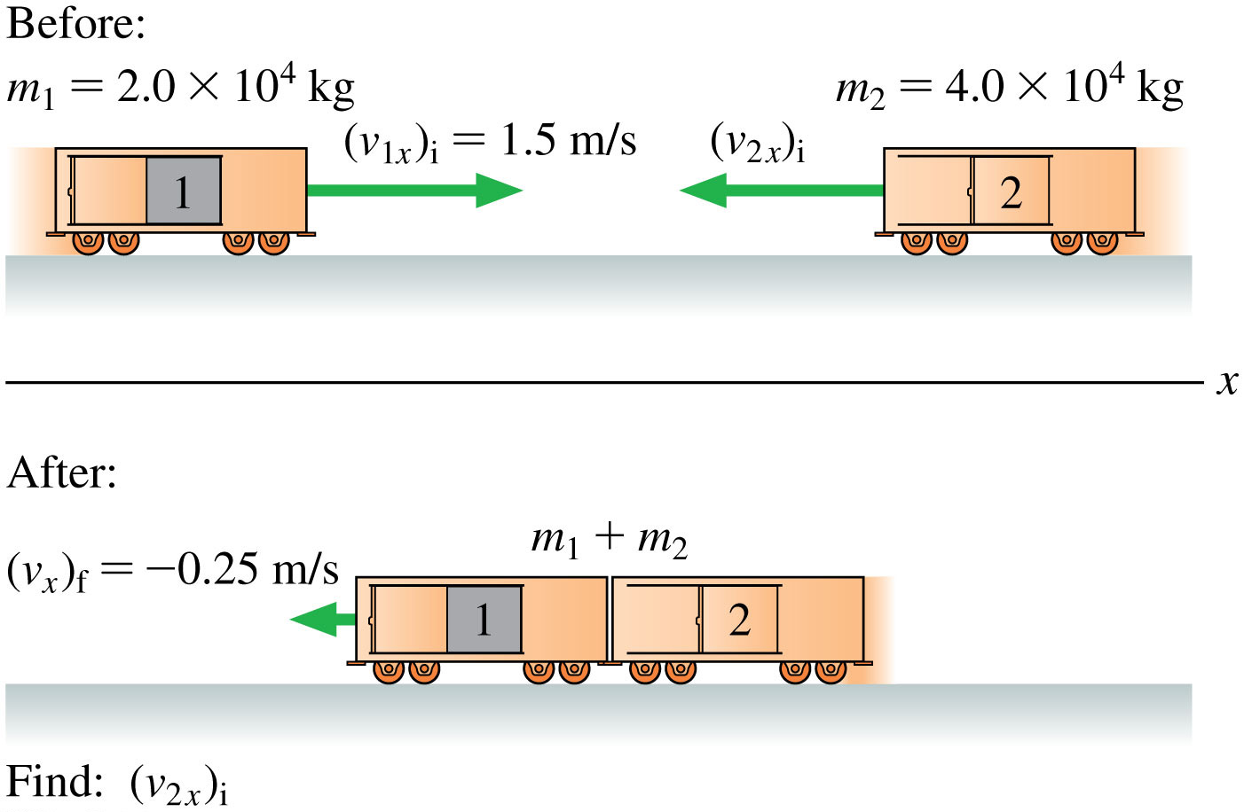
Example problem
Notes:
FIGURE 9.23

Slide 34
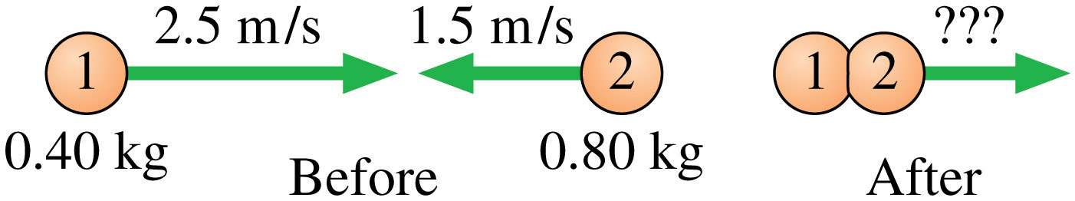
Example problem
Notes:
STOP TO THINK BOX 9.6

Slide 35
Example Problem
A 10 g bullet is fired into a 1.0 kg wood block, where it lodges. Subsequently, the block slides 4.0 m across a floor (µ_{k} = 0.20 for wood on wood). What was the bullet’s speed?
Slide 9-27

Slide 36
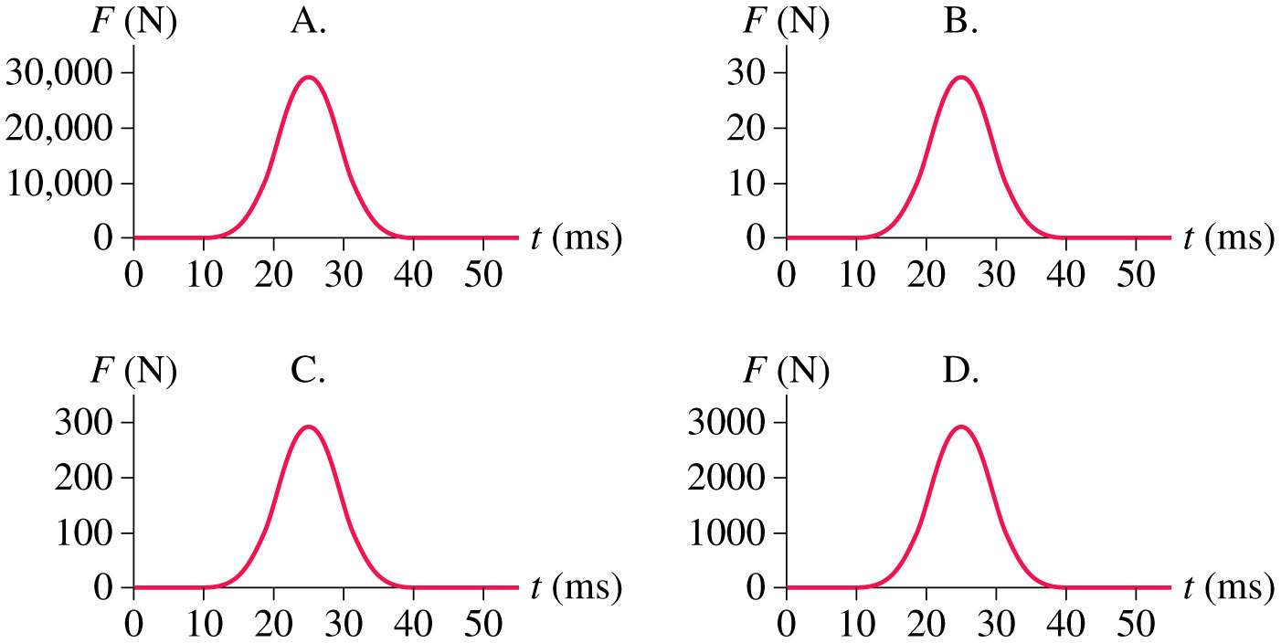
Which impulse would be a normal volleyball serve?
Notes:
FIGURE Q9.23

Slide 37
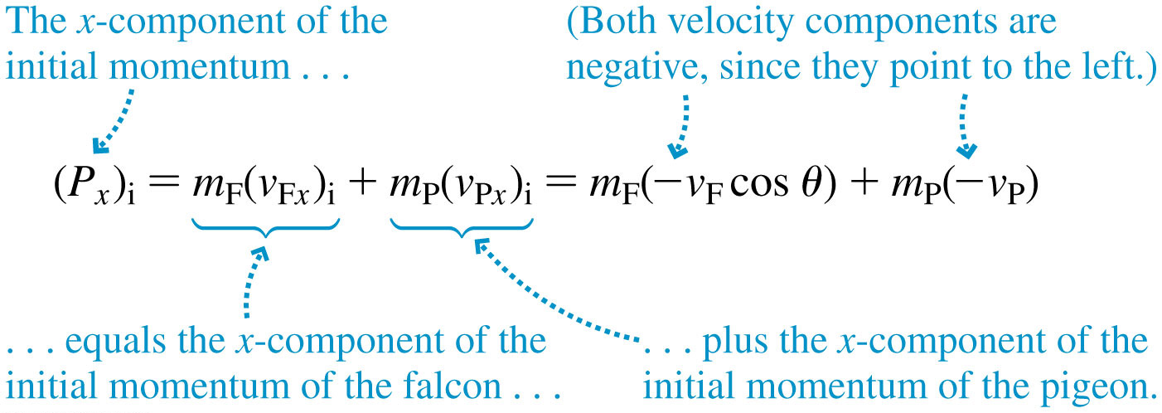
Watch your signs to avoid “here’s your sign”
Notes:
Chapter 9 Unnumbered Equation, Page 269

Slide 38
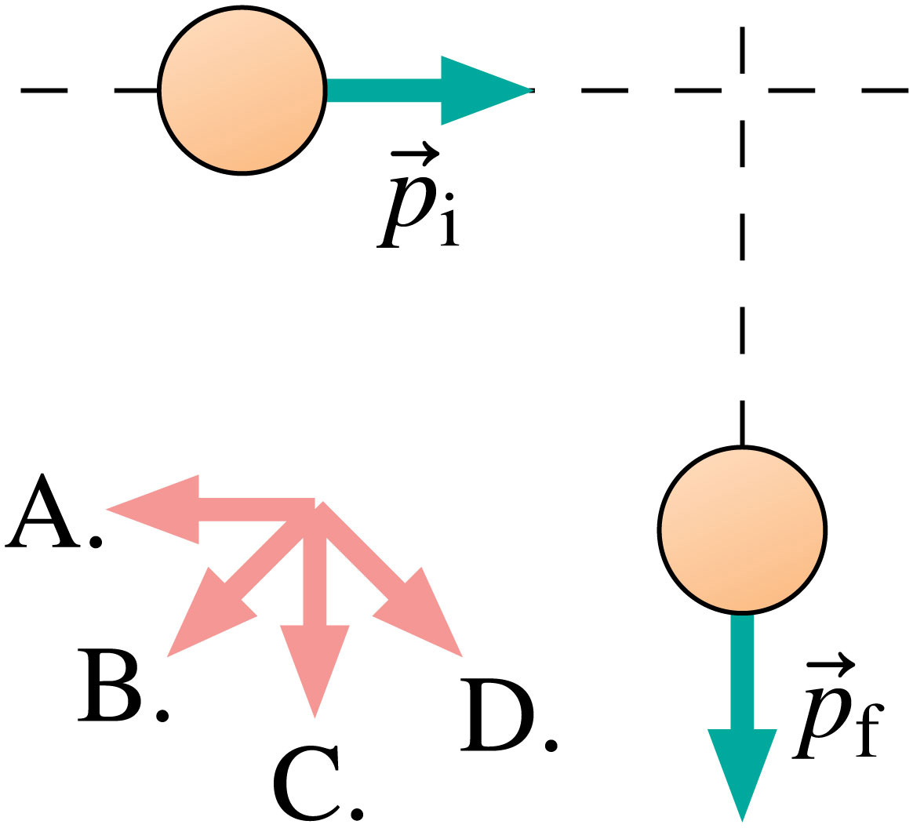
What direction was the impulse on this spherical peach-like object?
Notes:
FIGURE Q9.24

Slide 39
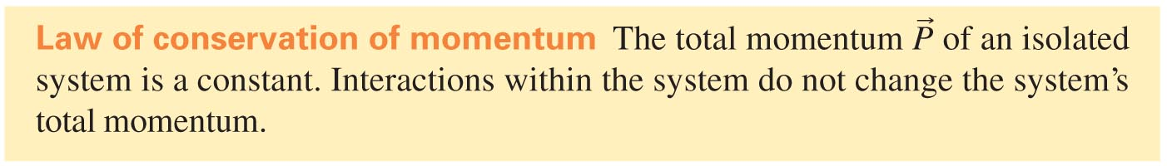

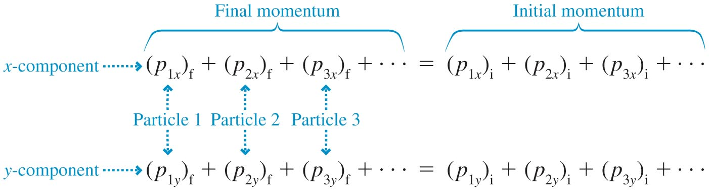
The Law of Conservation of Momentum
In terms of the initial and final total momenta:
In terms of components:
Slide 9-21

Slide 40
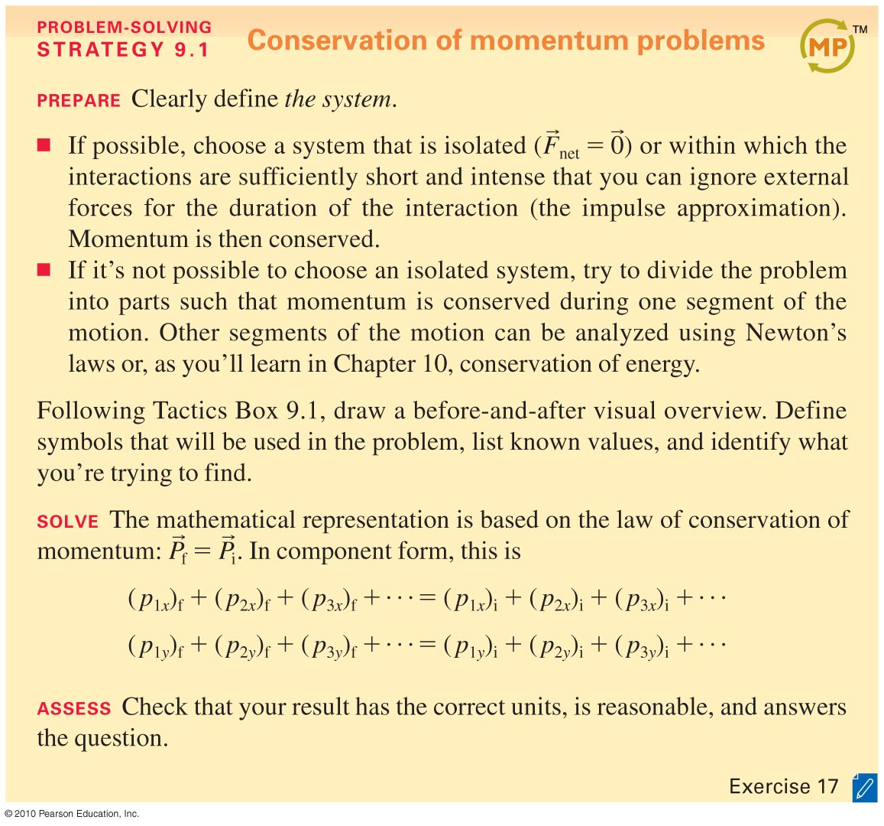
Slide 9-22

Slide 41
Example Problem
A curling stone, with a mass of 20.0 kg, slides across the ice at 1.50 m/s. It collides head on with a stationary 0.160-kg hockey puck. After the collision, the puck’s speed is 2.50 m/s. What is the stone’s final velocity?
Slide 9-23

Slide 42
Example Problem
Jack stands at rest on a skateboard. The mass of Jack and the skateboard together is 75 kg. Ryan throws a 3.0 kg ball horizontally to the right at 4.0 m/s to Jack, who catches it. What is the final speed of Jack and the skateboard?
Slide 9-26

Slide 43
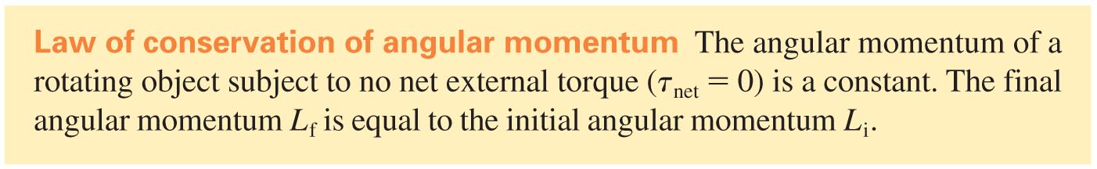
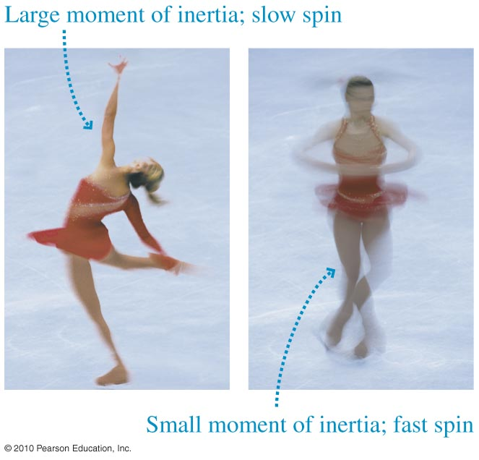
Conservation of Angular Momentum
Slide 9-28

Slide 44
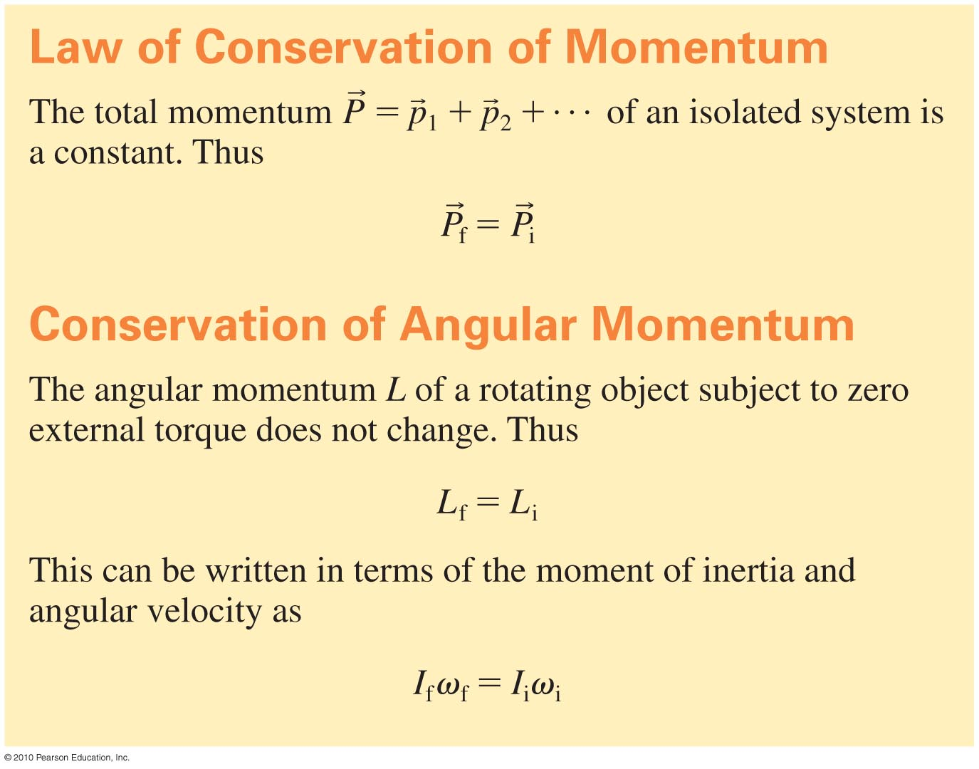
Summary
Slide 9-29

Slide 45
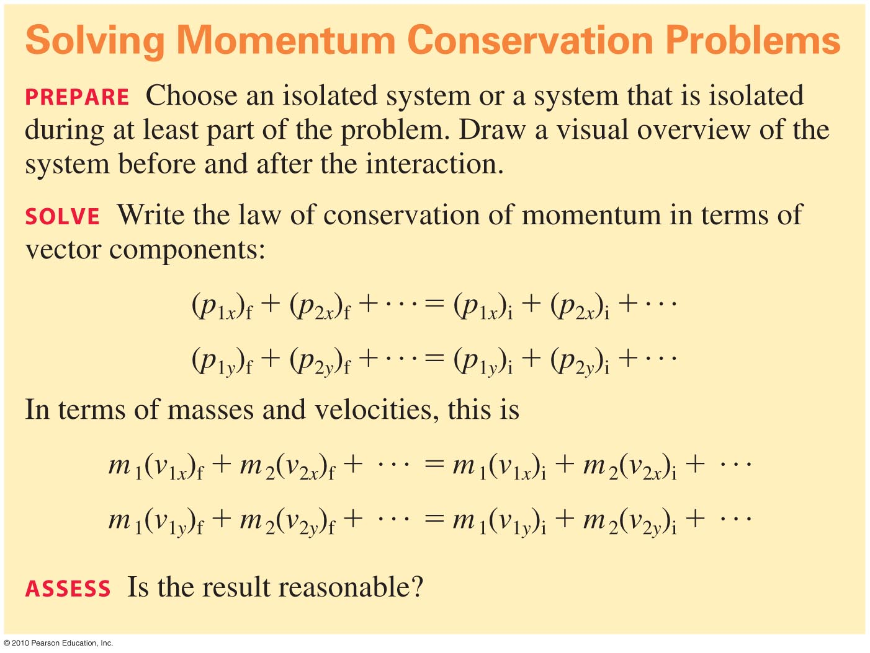
Summary
Slide 9-30

Slide 46
Additional Example Problem
A car traveling at 20 m/s crashes into a bridge abutment. Estimate the force on the driver if the driver is stopped by
a 20-m-long row of water-filled barrels
the crumple zone of her car (~1 m). Assume a constant acceleration.
Slide 9-35

Slide 47
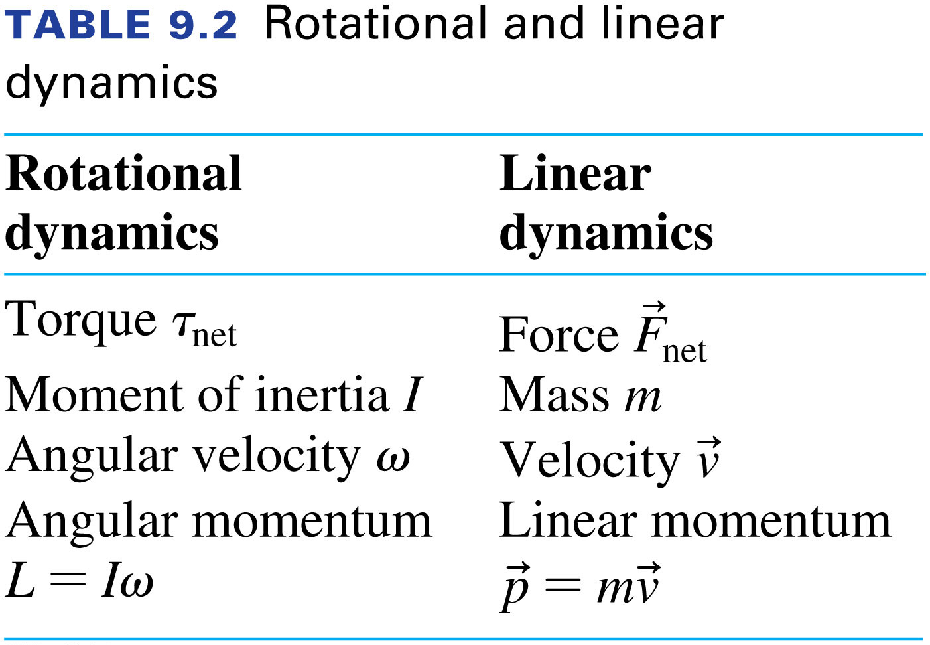
Notes:
Table 9.2

Slide 48
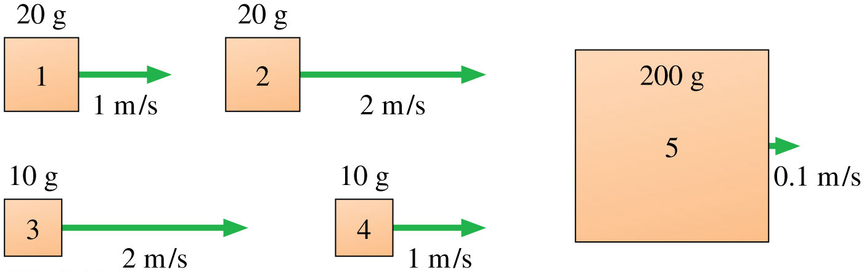
Example 9.8
Notes:
FIGURE Q9.1

Slide 49
Additional Example Problem
A 500 kg rocket sled is coasting at 20 m/s. It then turns on its rocket engines for 5.0 s, with a thrust of 1000 N. What is its final speed?
Slide 9-36

Slide 50
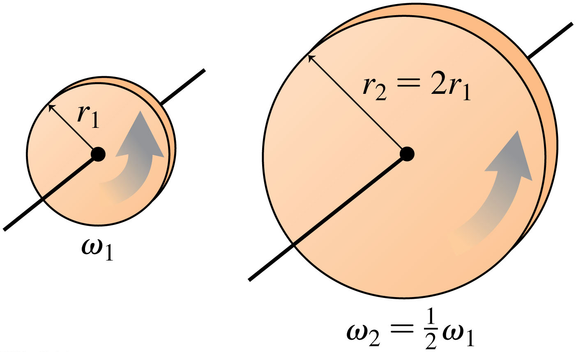
Which disk has a greater angular momentum?
Notes:
FIGURE Q9.18

Slide 51
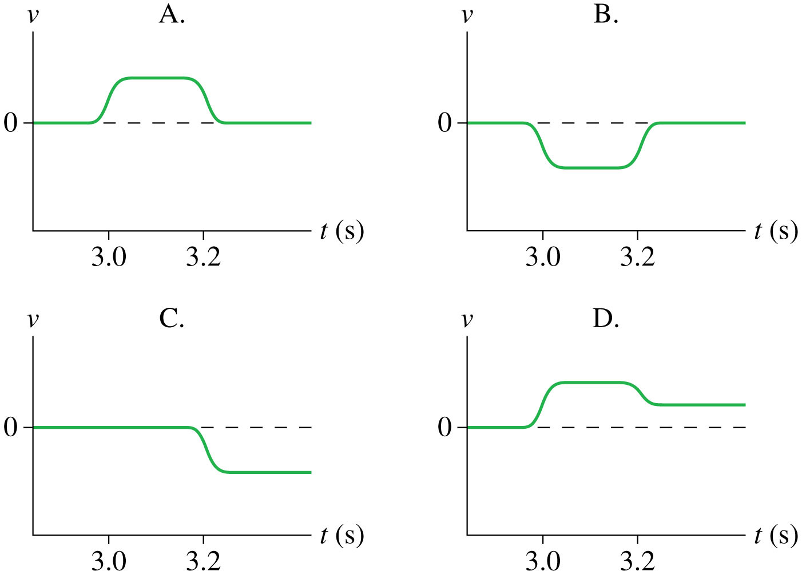
Can you describe the motion of these?
Notes:
FIGURE Q9.22

Slide 52
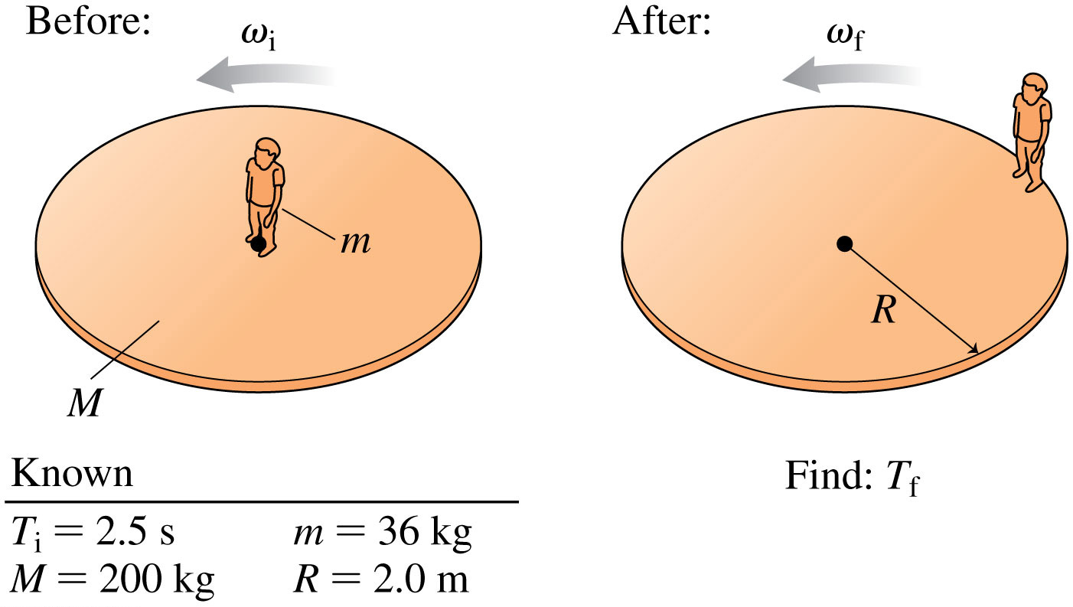
Find that thing they want you to find please
Notes:
FIGURE 9.27

Slide 53
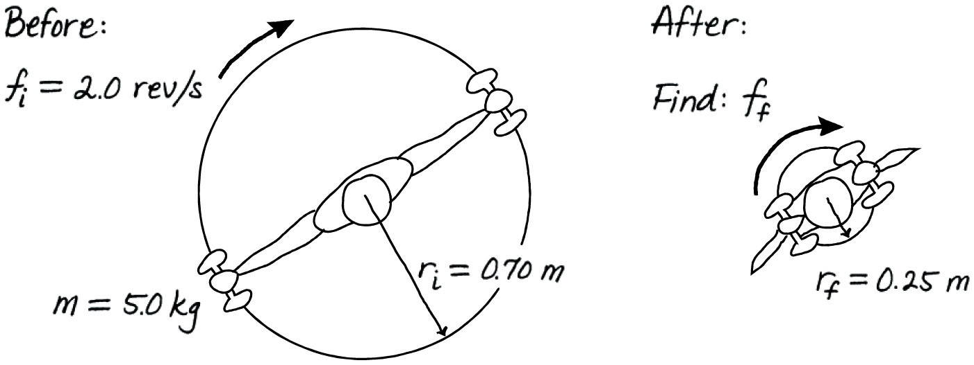

Find that thing they want you to find please
Notes:
FIGURE 9.29

Slide 54

What happens to the angular momentum here?
Notes:
STOP TO THINK BOX 9.7

Slide 55
END

